Slide 1
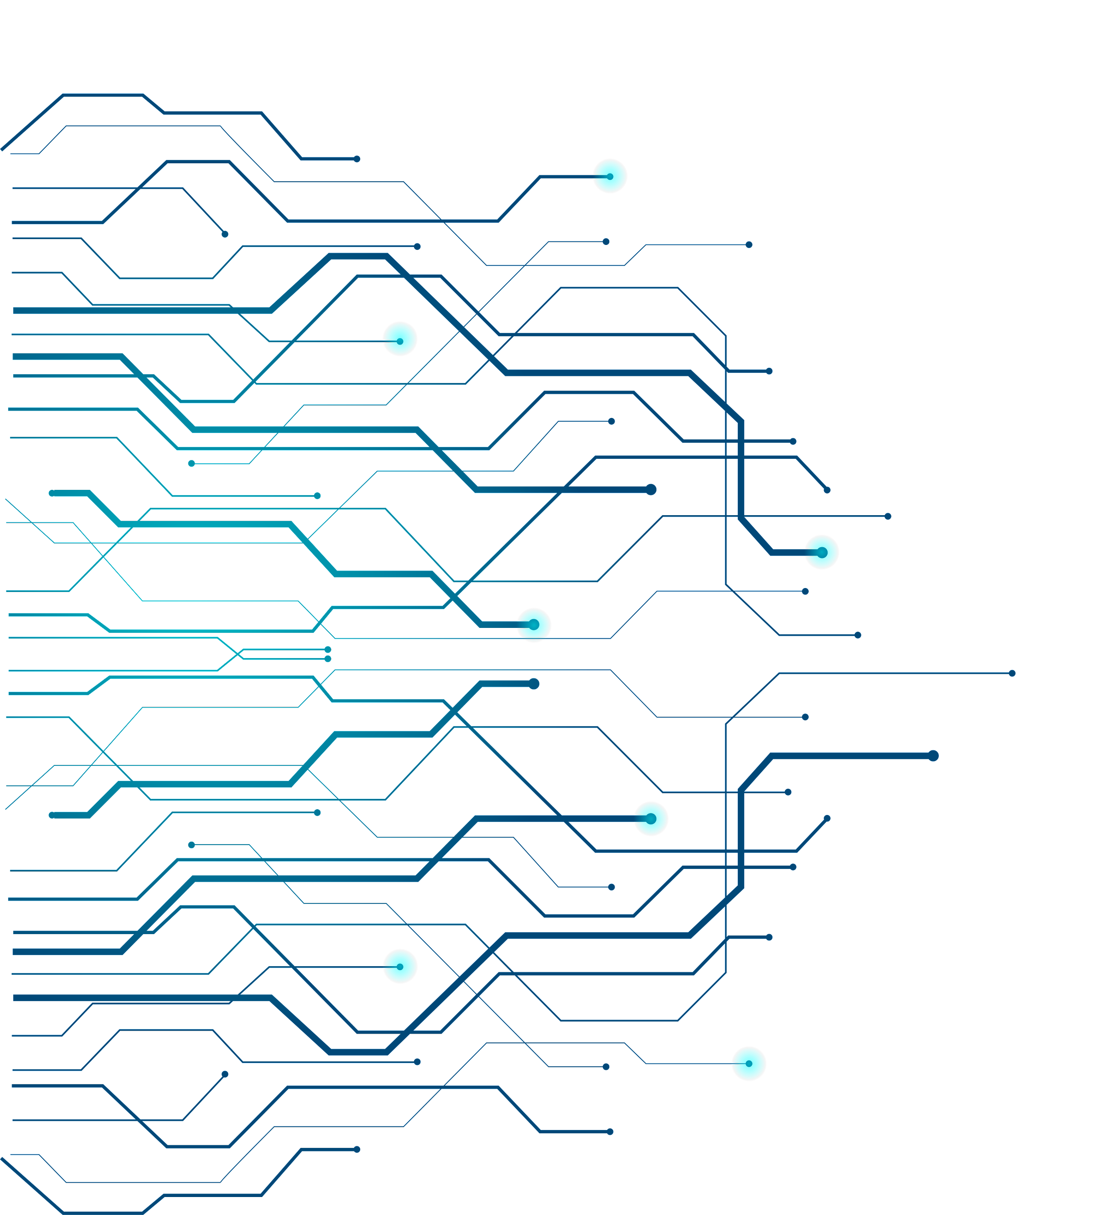
Basketball Game Outcome Prediction
Through Deep Learning
Group Members: Deevanshu Khatri, Joe Burns, Sonali Choudhary

Slide 2
01
03
05
Approach
Introduction to Dataset
Conclusion and Next steps
02
04
Challenges and Motivation
Model Summary and Model Evaluation
T
🠺
🠺

Slide 3
01
Introduction to Dataset
T
1
🠺
🠺
We have multiple datasets like NCAA tournament data, city data, conference data, coach data, season detail data and teams' data. We combined all the data. Performed feature engineering.
Notes:
Talk about data loading more if you want – add a slide next to this OR add the data loading points in slide number 4 and 5.

Slide 4
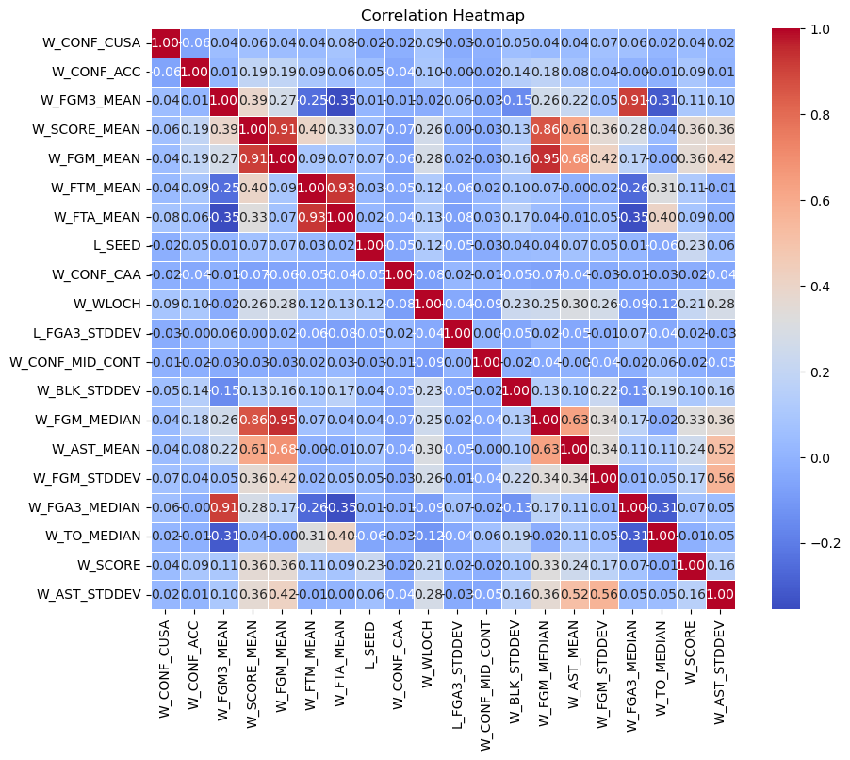
Exploratory Data Analysis
We used a combination of ibis and snowpark for data preprocessing and feature engineering.
Performed Principal Component Analysis and extracted the top 20 features out of 172.
Checked the Correlation matrix of the top 20 features.
Winning FGA3_Median and FGM3 mean have high correlation.

Slide 5
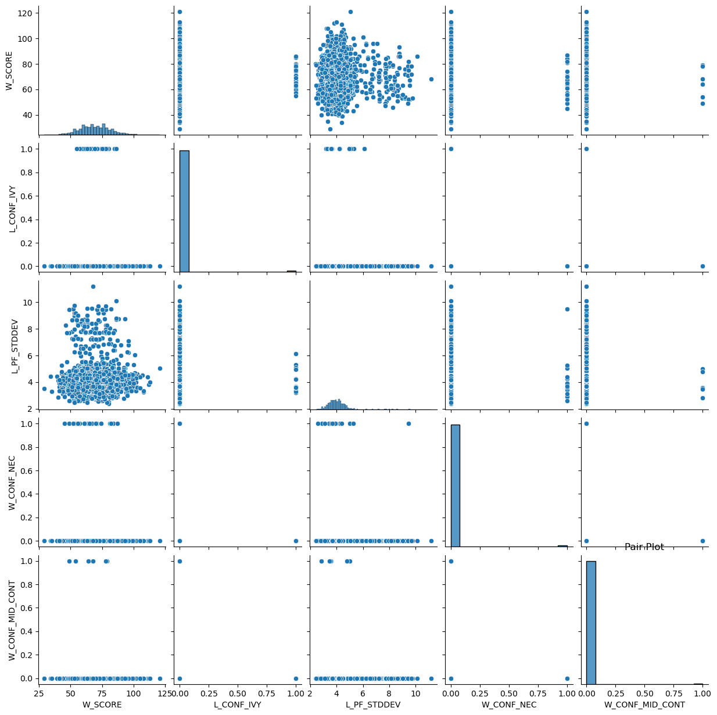
Performed Principal Component Analysis and extracted the top 5 features out of 172.
Analyzed the features using pair plots.
Wining score is roughly normally distributed
Whereas losing pf stddev is right skewed.

Slide 6
02
Challenges and Motivation
T
2
🠺
🠺

Slide 7
Data Selection
With 272 columns it was difficult to understand what will be useful from the sea of information
This step was completed with time and domain knowledge
Many of the features needed to be transformed in order to be useful for model training.

Slide 8
Neural Network Structure
There were lots of different attempts to optimize the structure of the deep neural network
Despite this, we were not able to achieve above our target accuracy of 75%
This was likely the wrong lever to keep pulling.
We believe that the best way to improve the accuracy is to include more data to help the optimal neural network predict. This is likely going to be window functions and lag features.

Slide 9
03
Approach
T
3
🠺
🠺

Slide 10
Pathway to Solution
In sports betting scenarios, ML-based approaches are being extensively utilized.
We conducted randomization on the data to ensure wins on both sides of the features, thus balancing the observations.
We have investigated numerous neural networks that people have used for sports betting and classification in general. They all adhere to the general structure of dense layers and activation functions, but we intend to experiment with deep layers to achieve the best-performing architecture.
We performed 13 models using different combinations of dense layers, activation functions, regularizations, and dropouts.

Slide 11
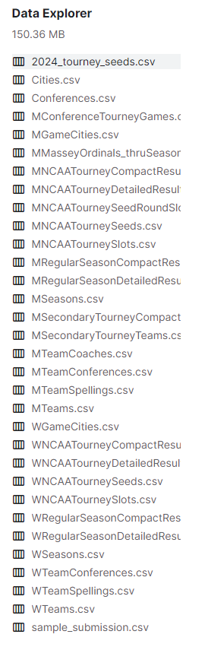
Data Aggregation
The data came in a series of csv files.
These CSVs were loaded into tables in Snowflake
We used Ibis and Snowpark to aggregate the data and build new features for the model training.
Final dataset was 172 predictors.

Slide 12
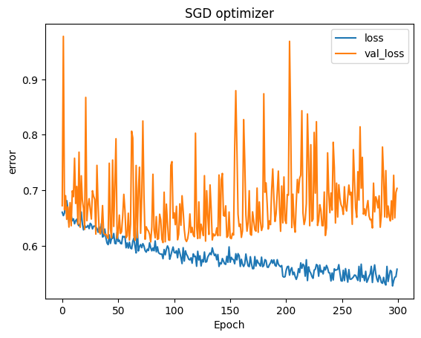
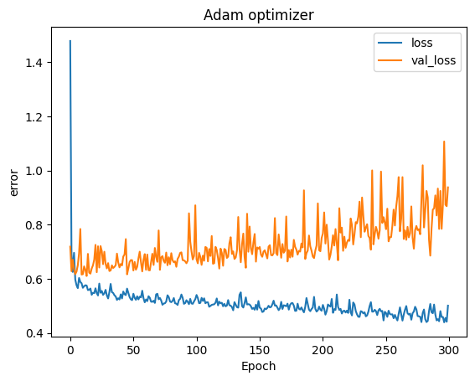
Adam optimizer outperformed SGD optimizer.

Slide 13
Pathway to Solution
After incorporating regularizations and dropouts, we observed that our models were experiencing underfitting.
To tackle the underfitting issue, we revisited the features in the dataset.
Upon analysis, we realized that rather than randomizing the data, a more effective approach would be to duplicate each game entry, flipping the teams' positions so that each game appears twice – once with the winning team and once with the losing team. This method ensures better balance in the data and eliminates inconsistencies that may arise from randomization.

Slide 14
04
Model Summary and Model Evaluation
T
4
🠺
🠺

Slide 15
Model Summary and Model Evaluation
Sr. No | Layer 1 | Layer 2 | Layer 3 | Layer 4 | Layer 5 | Layer 6 | Accuracy
1 | Dense(172, ReLU) | Dense(500, ReLU, L2 regularizer) | Dense(10, ReLU) | Dense(1, Sigmoid) |  |  | 64.9%
2 | Dense(172, ReLU) | Dense(500, ReLU, L2 regularizer) | Dense(500, ReLU) | Dense(172, ReLU) | Dense(10, ReLU) | Dense(1, Sigmoid) | 64.4%
3 | Dense(172, ReLU) | Dense(500, ReLU, L2 regularizer) | Dense(172, ReLU) | Dense(10, ReLU) | Dense(1, Sigmoid) |  | 49.6%
4 | Dense(172, ReLU) | Dense(1000, ReLU, L2 regularizer) | Dense(50, ReLU) | Dense(10, ReLU) | Dense(1, Sigmoid) |  | 65.7%
5 | Dense(172, ReLU) | Dense(1000, ReLU, L2 regularizer) | Dense(10, ReLU) | Dense(1, Sigmoid) |  |  | 49.6%

Slide 16
Model Summary and Model Evaluation
Sr. No | Layer 1 | Layer 2 | Layer 3 | Layer 4 | Layer 5 | Layer 6 | Accuracy
6 | Dense(172, ReLU) | Dense(250, ReLU, L2 regularizer) | Dense(10, ReLU) | Dense(1, Sigmoid) |  |  | 49.6%
7 | Dense(172, ReLU) | Dense(500, ReLU, L2 regularizer) | Dense(200, ReLU) | Dense(10, ReLU) | Dense(1, Sigmoid) |  | 49.6%
8 | Dense(172, ReLU) | Dense(500, ReLU, L2 regularizer) | Dense(75, ReLU) | Dense(1, Sigmoid) |  |  | 65.5%
9 | Dense(172, ReLU) | Dense(500, ReLU) | Dense(10, ReLU) | Dense(1, Sigmoid) |  |  | 49.6%
10 | Dense(172, ReLU) | Dense(750, ReLU, L2 regularizer) | Dense(10, ReLU) | Dense(1, Sigmoid) |  |  | 49.6%

Slide 17
Model Summary and Model Evaluation
Sr. No | Layer 1 | Layer 2 | Layer 3 | Layer 4 | Layer 5 | Layer 6 | Accuracy
11 | Dense(172, ReLU) | Dense(2000, ReLU, L2 regularizer) | Dense(10, ReLU) | Dense(1, Sigmoid) |  |  | 49.6%
12 | Dense(172, Sigmoid) | Dense(2000, Sigmoid, L2 regularizer) | Dropout(0.1) | Dense(10, Sigmoid) | Dense(1, Sigmoid) |  | 49.6%
13 | Dense(172, Sigmoid) | Dense(2000, Sigmoid, L2 regularizer) | Dropout(0.2) | Dense(10, Sigmoid) | Dense(1, Sigmoid) |  | 67.5%
14 | Dense(172, Sigmoid) | Dense(2000, Sigmoid, L2 regularizer) | Dropout(0.3) | Dense(10, Sigmoid) | Dense(1, Sigmoid) |  | 68.3%

Slide 18
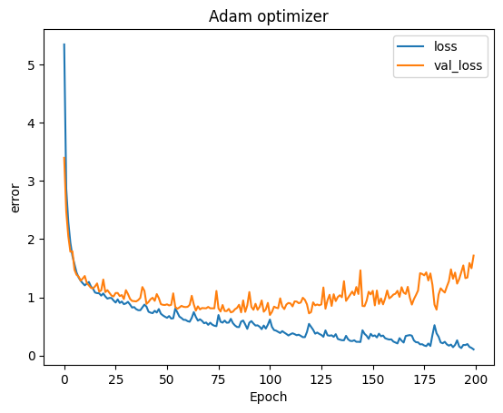
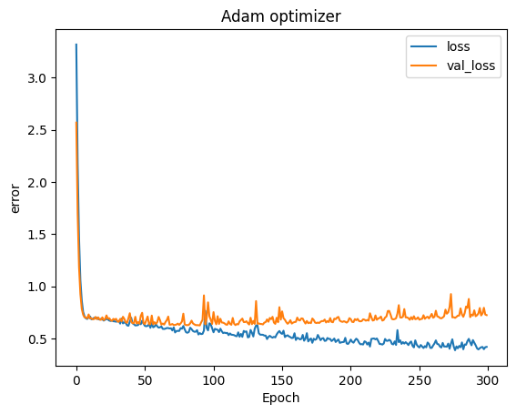
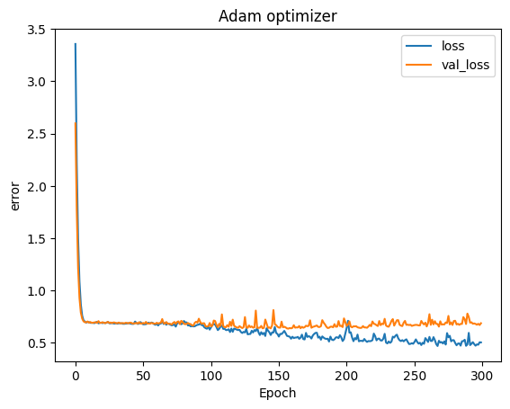
Cross entropy Loss curve of Top 3 Performing Model
Model 4
Model 13
Model 14

Slide 19
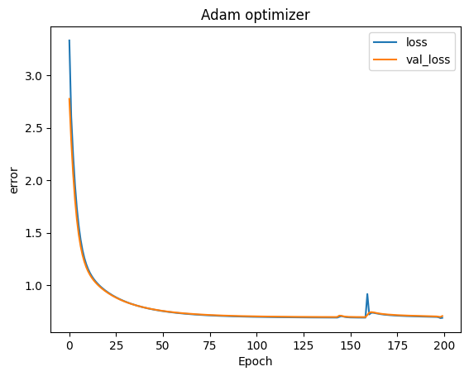
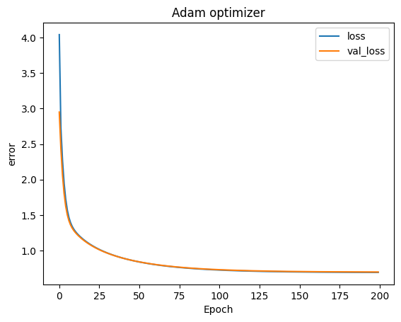
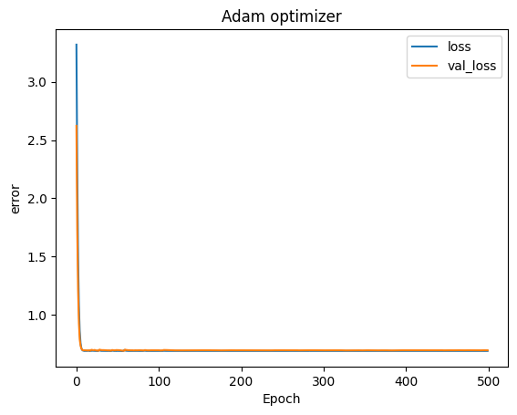
Cross entropy Loss curve of Overfitting Models
Model 3
Model 5
Model 12

Slide 20
05
Conclusion and Next Steps
T
5
🠺
🠺

Slide 21
Conclusion and Next steps
It appears that we achieved the best results with our 14th model, utilizing a 0.03 dropout rate and a 2000-unit first deep layer with regularization, resulting in an accuracy of 0.6835.
This performance is quite promising for sports betting. We hypothesize that in instances of good model performance but underfitting, we may lack sufficient data to comprehensively address our query. The next steps could involve incorporating rolling averages and window functions, which could serve as significant differentiators.
Next Steps:
Circle back to feature engineering and build more value velocity features. We believe that rolling averages and rate of change features will help with current state.
For example: NC State had a poor regular season, but did exceptionally in the ACC tournament. The data within was more aligned with their performance in the NCAA tournament.

Slide 22
Appendix

Slide 23
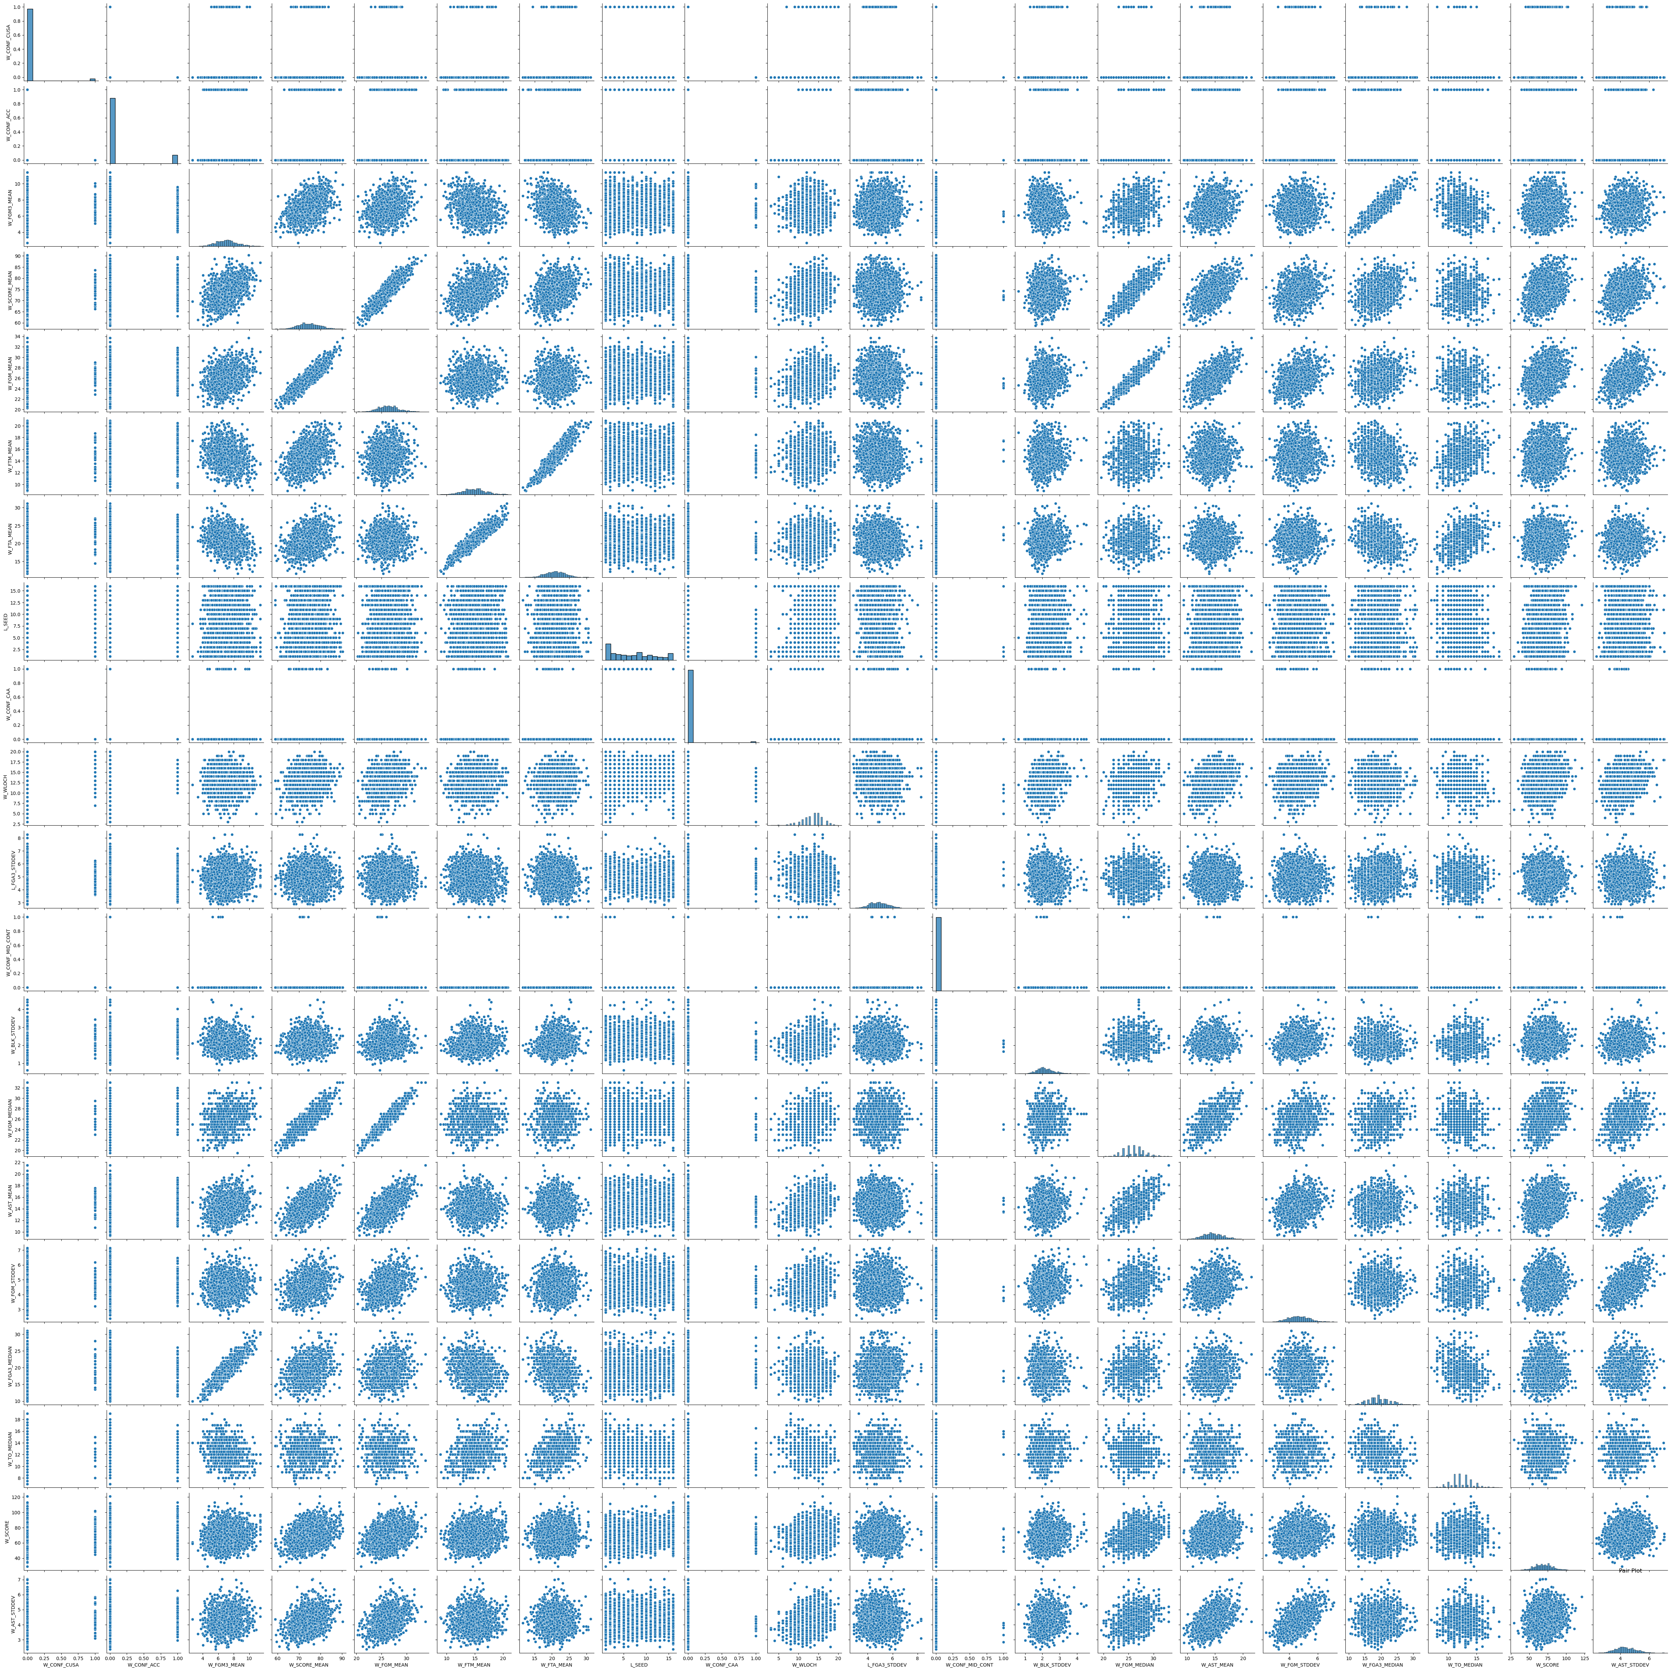
Performed Principal Component Analysis and extracted the top 20 features out of 172.
Analyzed the features using pair plots.

